Slide 1
Small RNA-seq Analysis of
Drosophila melanogaster loqs Mutants

Slide 2
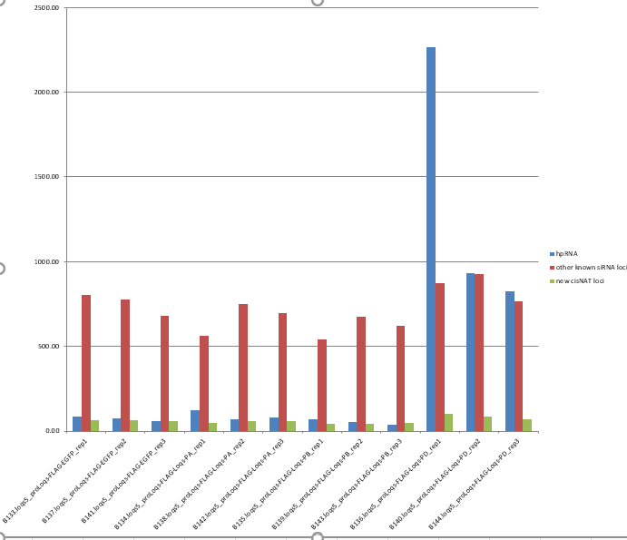
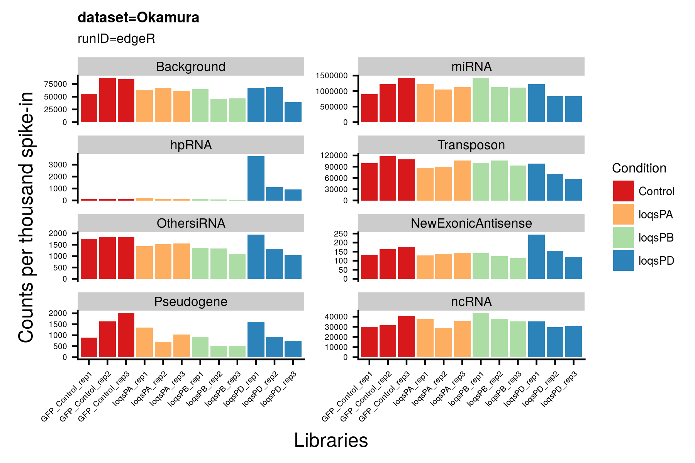
Update on Initial Findings
A) Initial mapping results by Dr Liling
B) Current mapping results
*Note, ‘OthersiRNA’ index comprises of mappings to 4 collections of published siRNA generating loci.

Slide 3
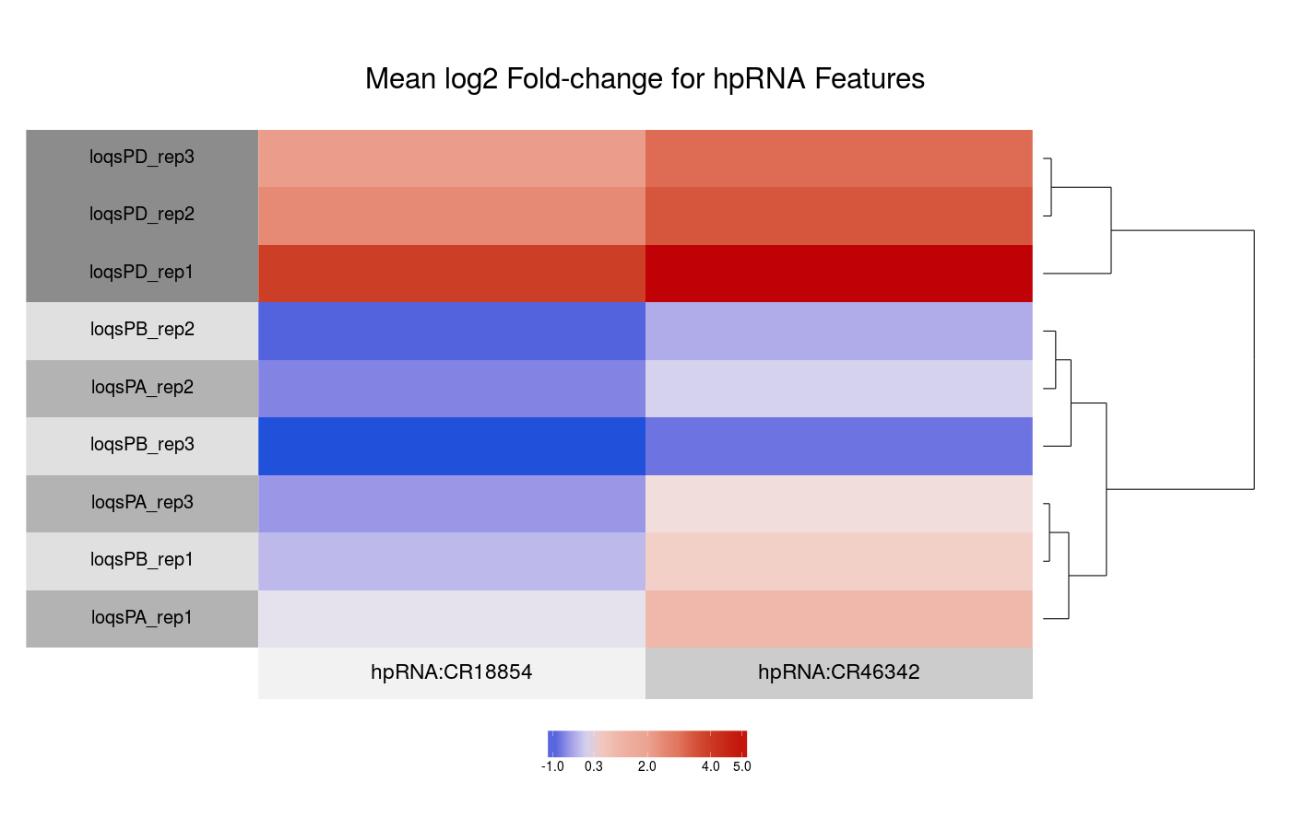
Fold Change Analysis of Initial Findings
1 count was added to each feature post-normalization.
Only features which accumulated > 50 total normalized counts across all libraries are shown.
CR18854 -> esi-1 / CG18854
CR46342 -> esi-2 / G4068B

Slide 4
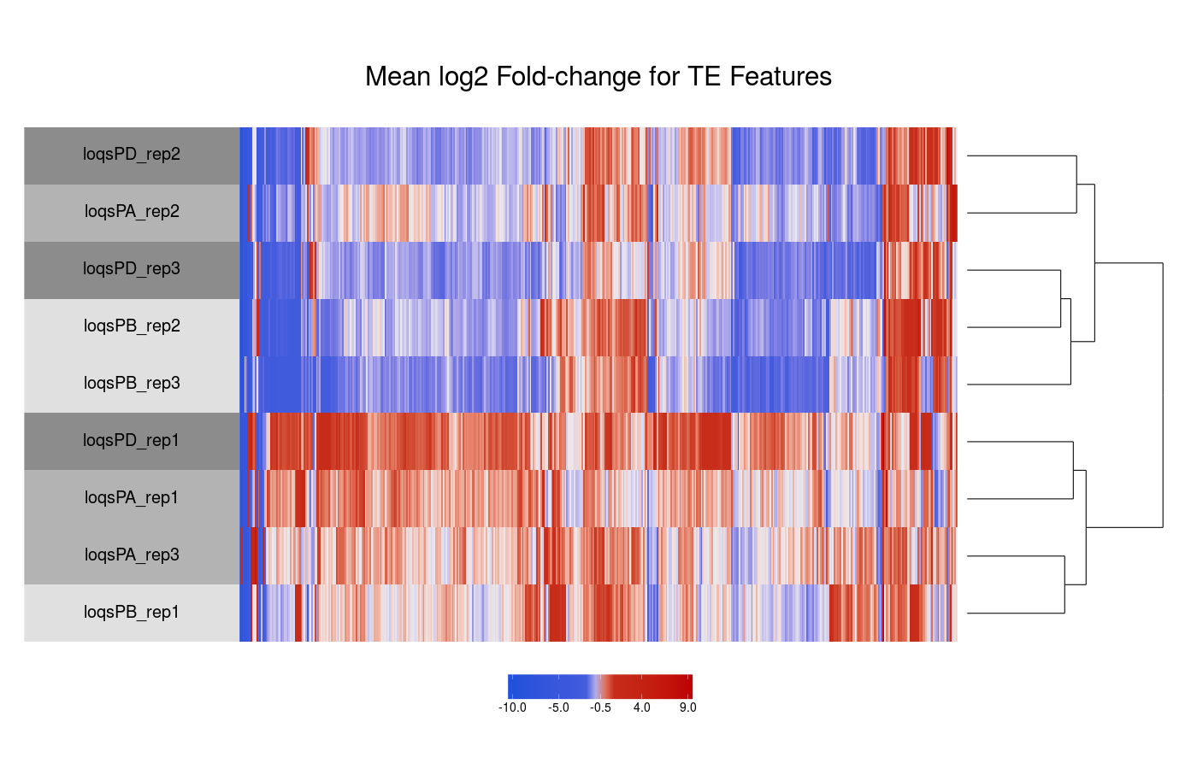
Fold Change Analysis of Initial Findings
Conclusion:
K-means clustering shows that substantial variation was present between replicates and as such, we could not draw a solid conclusion for the fold change of Transposable Element derived endo-siRNA features

Slide 5
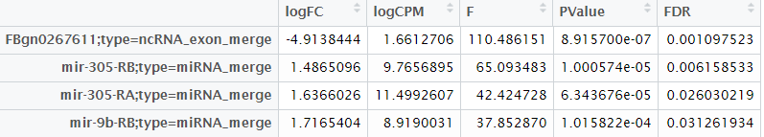
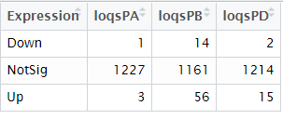
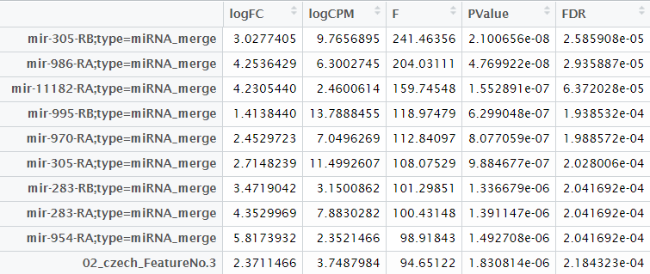
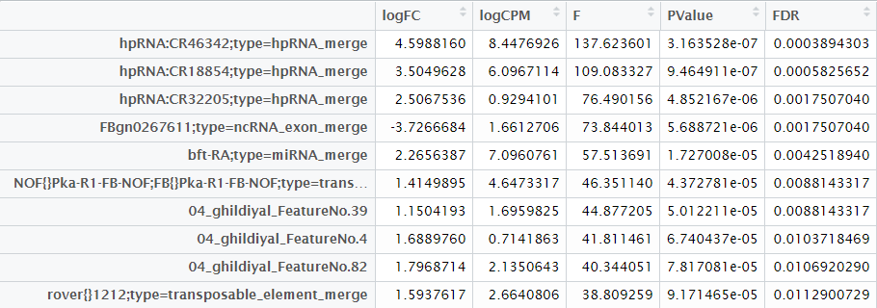
Differential Gene Analysis of Initial Findings
LoqsPA
Summary Table for DGE
LoqsPB
esi-1, esi-2 and CR32205 are differentially upregulated in the LoqsPD rescue.
50+ miRNA features are up-regulated in LoqsPB rescue.
No clear indication of differential expression for Citation or Transposable Element features.
Interestingly, FBgn0267611 shows consistent down-regulation across all conditions.
LoqsPD
hpRNA

Slide 6
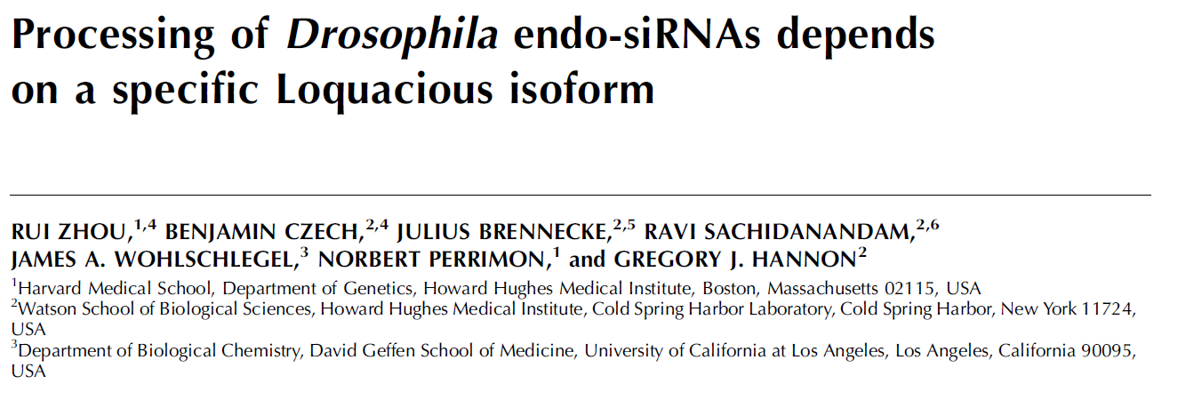
GSE17171 (2009)
Key Findings
The re-expression of LoqsPD in a Loqs-ORF knockout background restored esi-2.1 levels, while the re-expression of LoqsPB restored miR-bantam levels.
All four Loqs isofoms and R2D2 were able to interact with Dcr-2.
All four Loqs isofoms are capable of forming homo/heterodimers (or even oligomers) with each other.
Small RNAs from S2 cell treated with Loqs-ORF, Dcr-1, Dcr-2, R2D2 and lacZ dsRNA, along with untreated cells (‘‘mock’’) were sequenced.
Endo-siRNAs mapping to: 1) overlapping transcripts (exonic antisense), 2) transposable elements + repeats and 3) structured loci (hairpin RNA) were strongly reduced in Dcr-2 and Loqs-ORF knockdowns. R2D2 knockdown showed minor effects.
Northern blotting confirmed decreased levels of esi-1.2, esi-2.1 and esi-4.1 in Dcr-2 and Loqs-ORF knockouts.

Slide 7
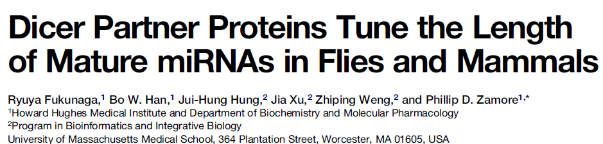
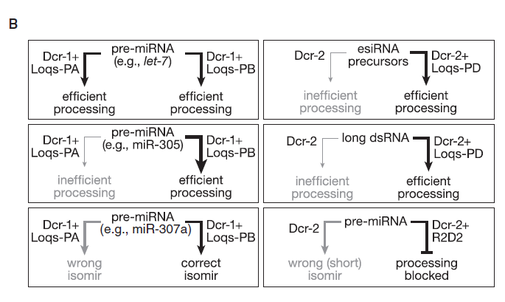
GSE37443 (2012)
Key Findings
GFP assays showed that the processing of both hairpin-derived and transposon-targeting endo-siRNAs does not depend on R2D2.
Created small RNA datasets with LoqsPA, PB and PD rescued in various combinations against a Loqs-ORF knockout background in both Fly head and Ovary. Interestingly, they did not have a LoqsPD rescue library.
By comparing LoqsPA, LoqsPB, LoqsPA +LoqsPB, LoqsPA + LoqsPD, LoqsPB + LoqsPD libraries, they concluded that Endo-siRNA biogenesis as a whole requires LoqsPD.

Slide 8
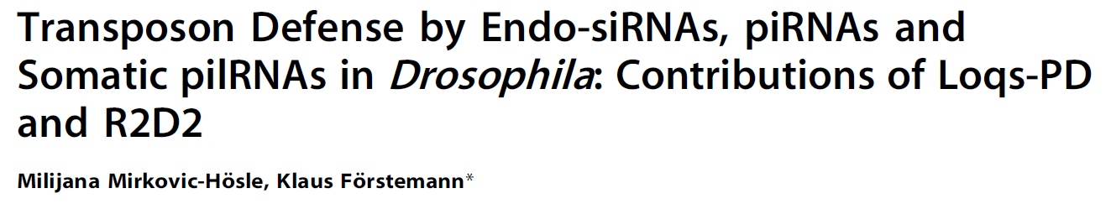
GSE45290 (2014)
Key Findings
Somatic and germline Small RNAs from Loqs-ORF Knockout (supplemented with Loqs-PB) and R2D2 Knockout lines were sequenced.
A reduction in transposon mapping endo-siRNAs (TE siRNAs) was observed in Loqs-ORF Knockout lines. This observation was attributed to LoqsPD.
A loss of R2D2 even led to a small increase in TE siRNAs in the germline and only a small number of transposon mapping endo-siRNAs showed clear R2D2 dependency.
Authors concluded that R2D2 and LoqsPD could have competing/ overlapping function but could not ascertain why certain TE siRNAs show a R2D2/Loqs preference.

Slide 9
Formulation of Initial Hypothesis
Other studies have shown that a Loqs-ORF knockdown results in a decrease in both hairpin and non-hairpin endo-siRNAs.
In addition, several studies attribute variations in endo-siRNA levels in a Loqs-ORF knockdown background entirely to LoqsPD.
Our initial results suggest that the production of 2~3 species of hpRNAs, but not other endo-siRNAs, has a nearly absolute requirement for LoqsPD
We therefore hypothesize that despite being solely required for hpRNA production, LoqsPD has to function in combination with other Loqs isoforms or even R2D2 for the efficient biogenesis of non-hairpin derived siRNAs.

Slide 10
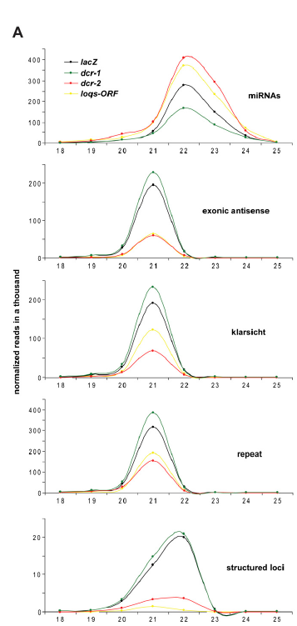
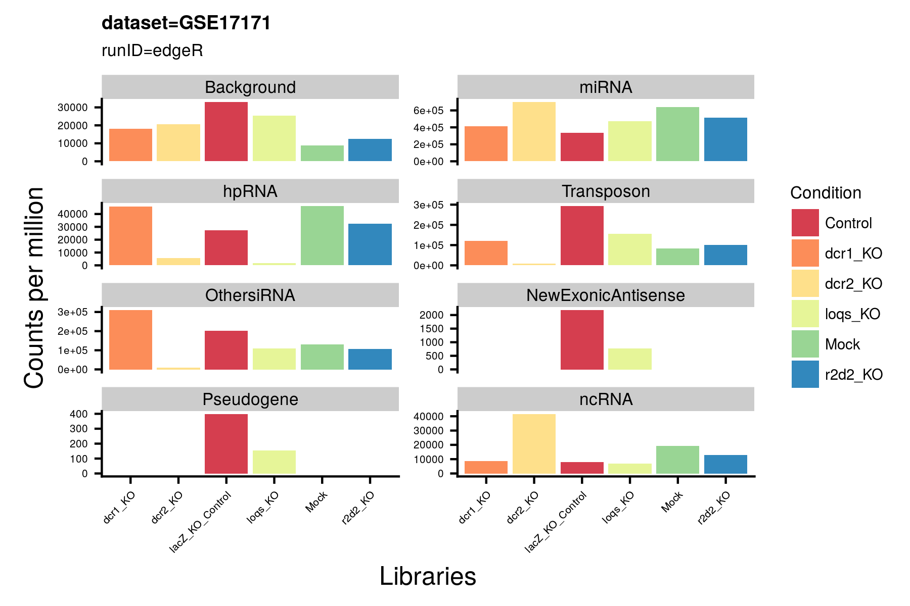
Analysis of GSE17171
A) Published analysis
B) Our analysis
Conclusions:
While our mapping involves different classification of features, the general trend for ‘structured loci’/hpRNA appears to be similar.
Reads mapping to ‘Transposon’ and ‘OthersiRNA’ features are drastically decreased in dcr2_KO but only slightly decreased in both loqs_KO and r2d2_KO. Interestingly, dcr1_KO also experienced a decrease in ‘Transposon’ reads.

Slide 11
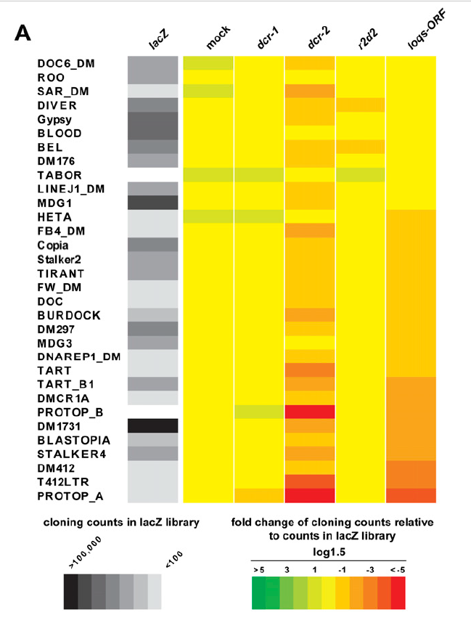
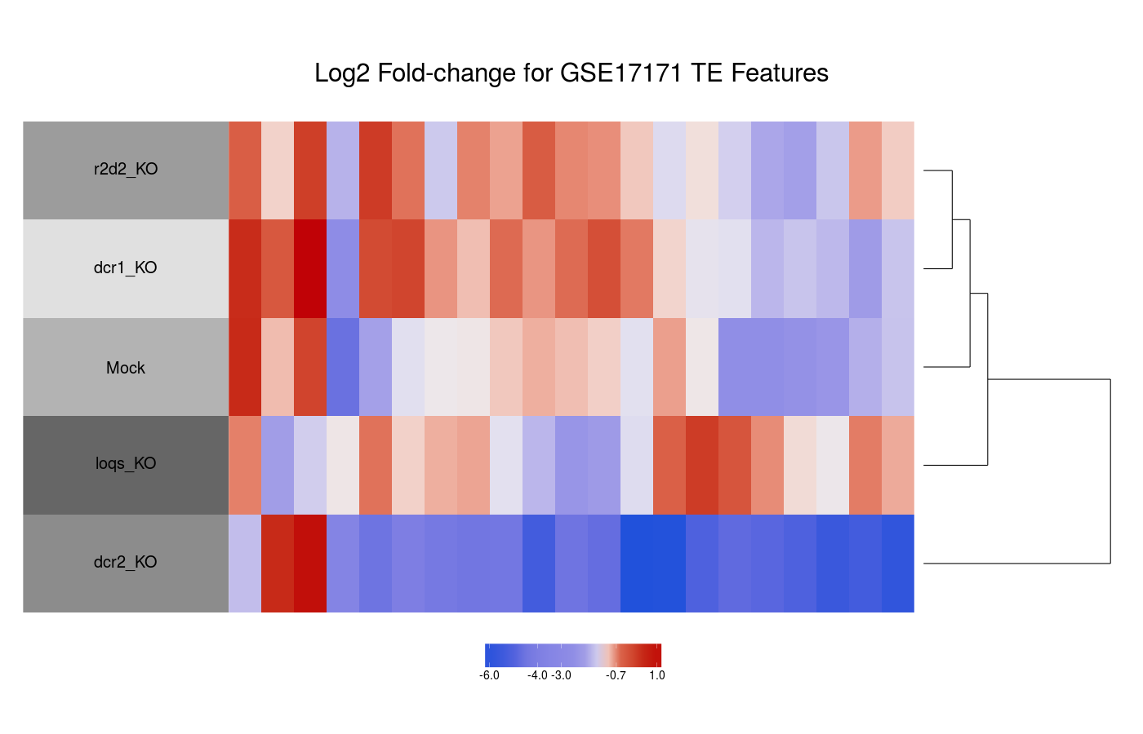
Analysis of GSE17171
Conclusion:
Using the same filtering conditions as the authors (>5 reads per library, >500 across all libraries), we obtained a similar FC profile.
Results again suggest overlapping roles between R2D2 and Loqs in TE endo-siRNA biogenesis.

Slide 12
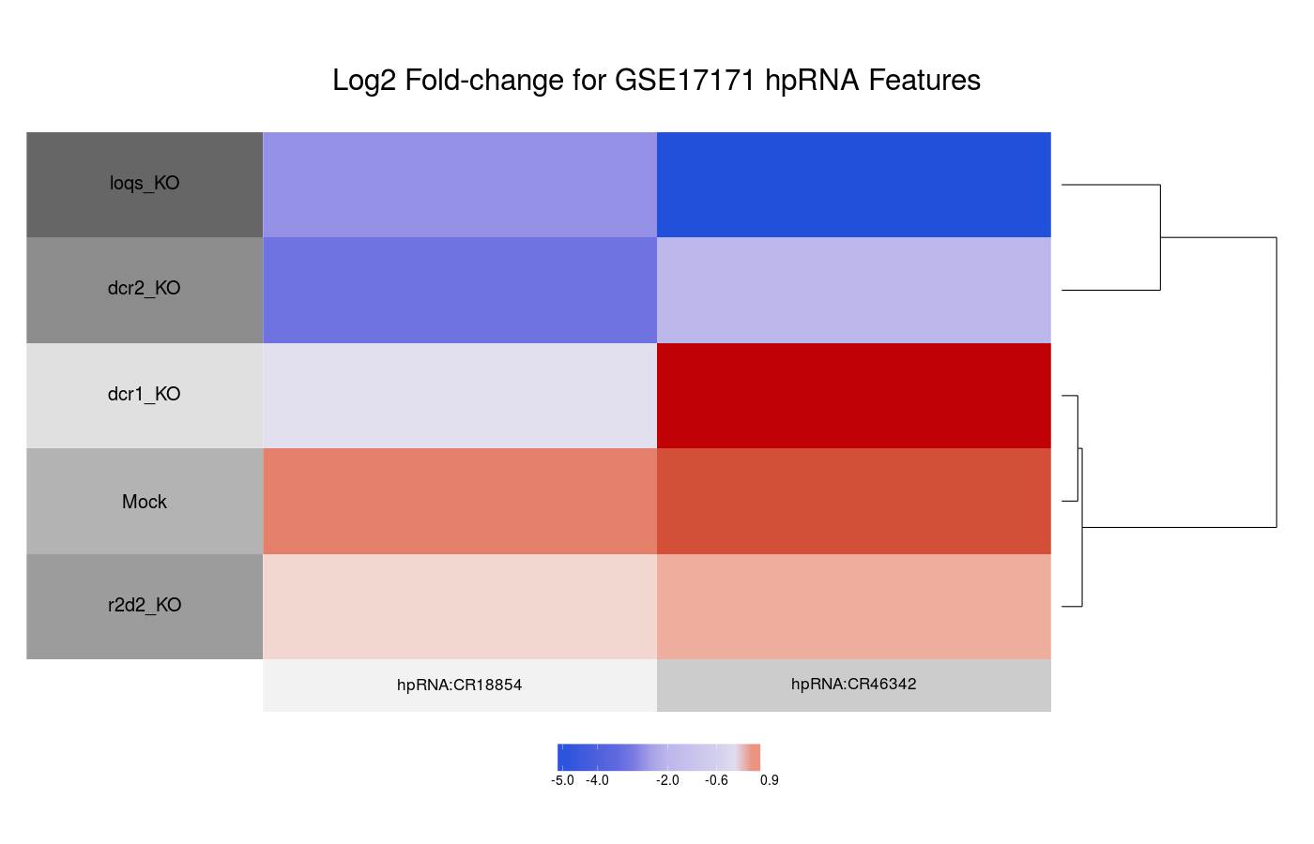
Analysis of GSE17171
Conclusion:
Similar to our dataset, esi-1 and esi-2 are the only 2 hpRNA loci that accumulate sufficient reads for our fold-change analysis.
Notes:
Note for Kawamura,Okamura,, only LoqsKO and lacZ_control show any amount of counts.
AHH it seems that a large amount of counts are concentrated in 02_Czech and its only in 3 features. Super weird. Damn and it’s the same trend, loqsKO, lacZ and mock show like 20x higher counts than the other KOS. Damn ghidyayal is buggy
For TE, while the other conditions do show some measure of counts for certain TE features, for a large majority, it also shares the same situation as kawamura.
That’s perhaps why the paper introduced the filter?

Slide 13
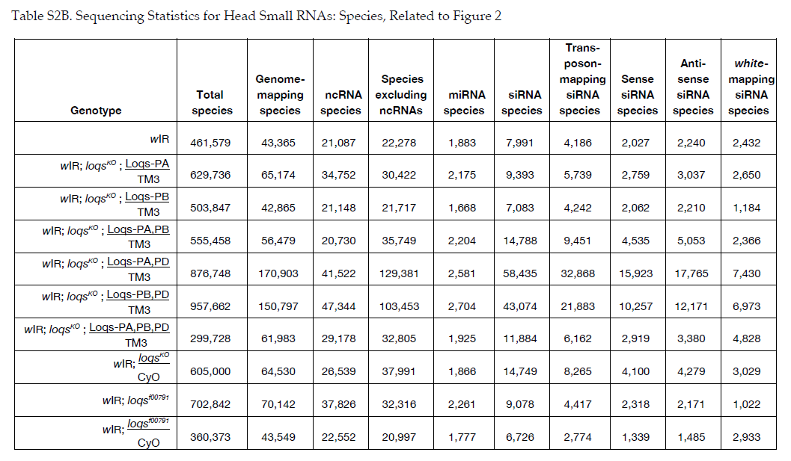
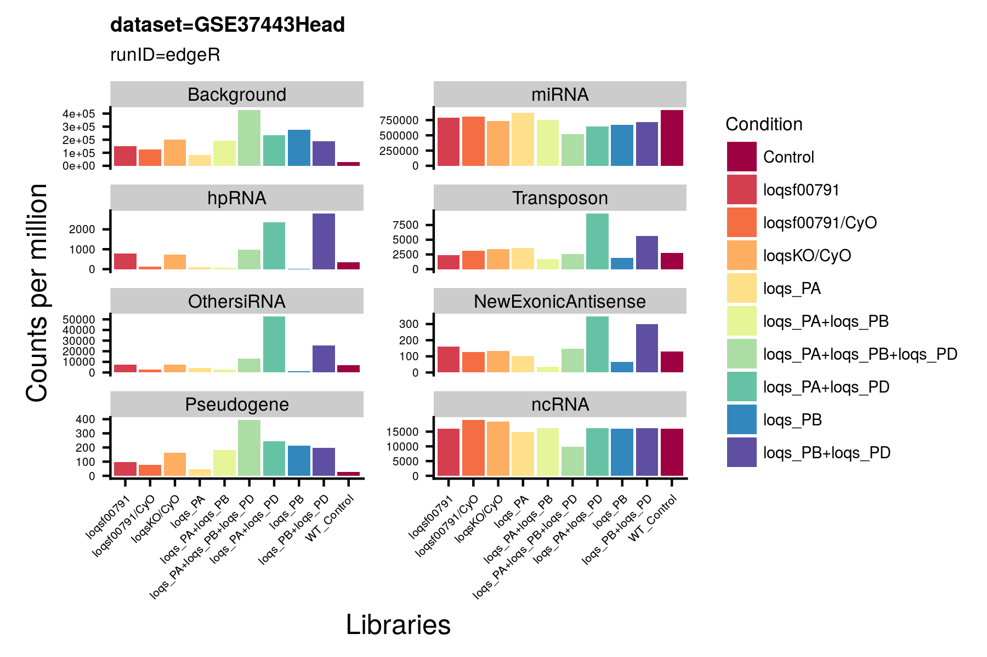
Analysis of GSE37443Head
A) Published analysis
B) Our analysis
Conclusion:
Despite slightly different feature classifications, our analysis shows similar read count distributions for endo-siRNA related feature types, notably: 1) hpRNA and OthersiRNA, 2) Transposon and 3) NewExonicAntisense.
For these features, the LoqsPD + LoqsPA/PB rescue combinations show much higher read counts than any other rescue combination.

Slide 14
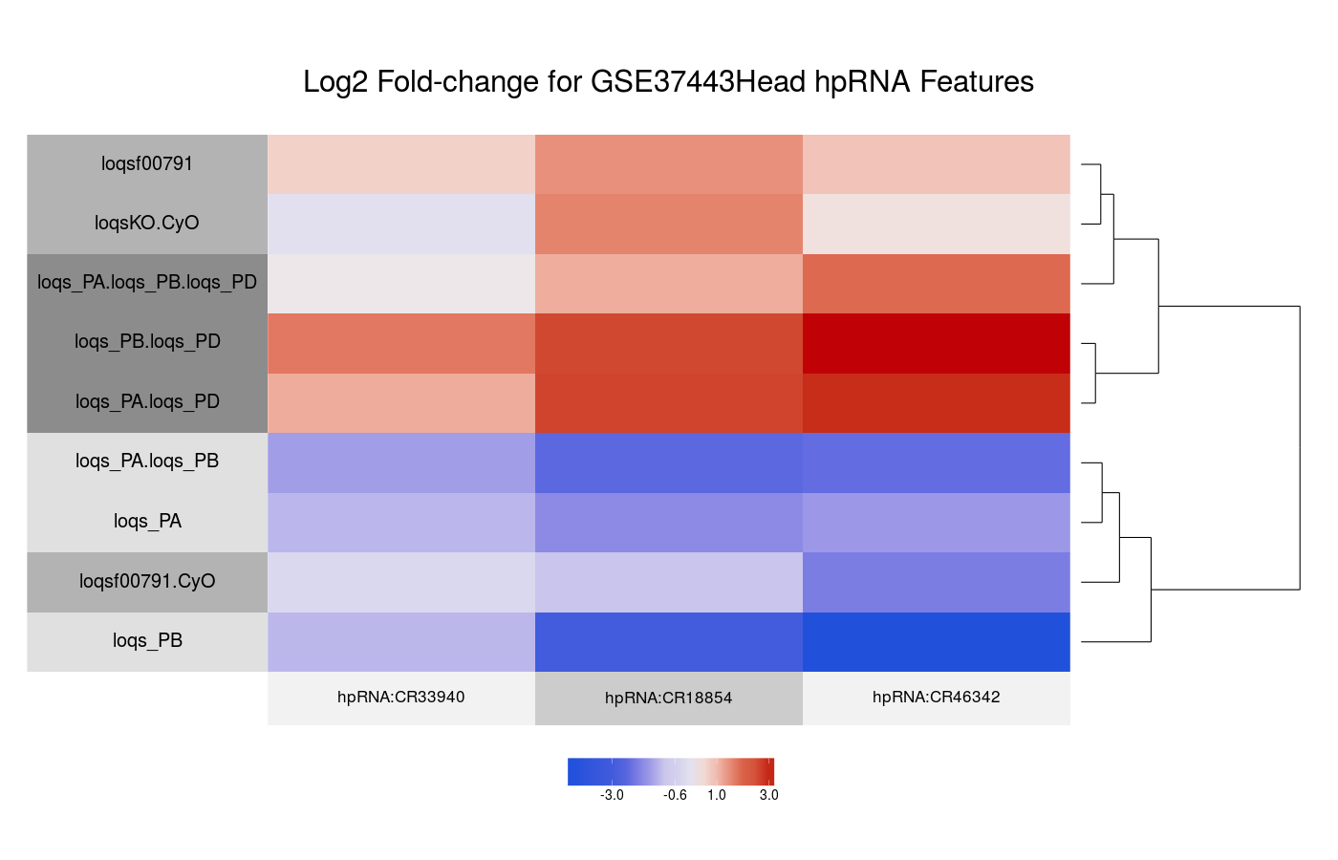
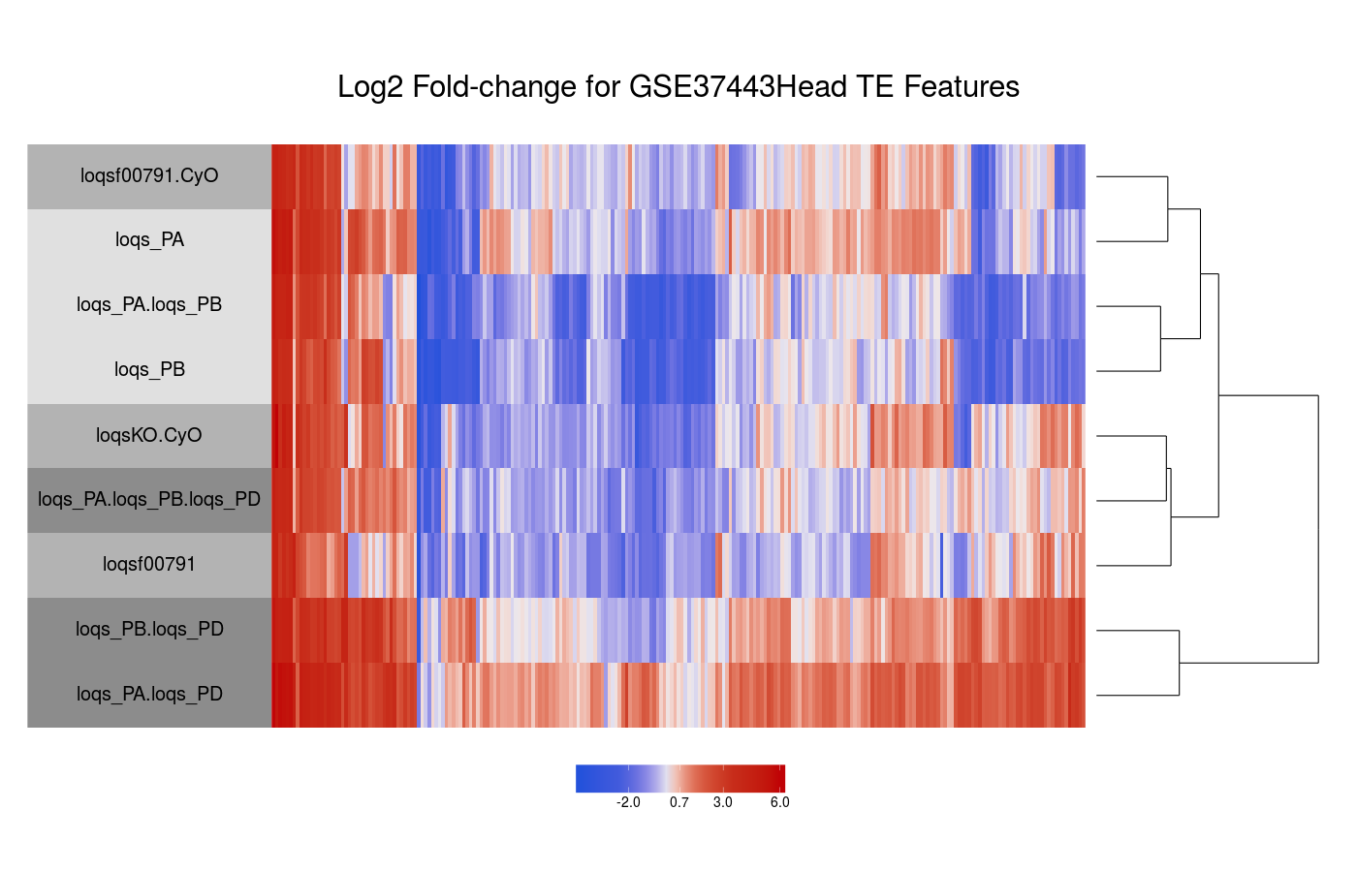
Analysis of GSE37443Head
Conclusion:
Taking the analysis of our original dataset into consideration, these results suggest that LoqsPD alone is necessary and sufficient for the production of predominant hpRNA features but functions in tandem with LoqsPA/PB for optimal production of non-hairpin derived endo-siRNA features.

Slide 15
Future Work
There are datasets (with 2 replicates) of WT Canton-S, 0-1hr (GSE40042) ,2-6 hr (GSE40039) and 6-10 hr (GSE40040) embryo small RNA seq which we have yet to examine. We could potentially use these for a WT-baseline.
The distribution of reads mapped to the 4 collections of published features in the `OthersiRNA` index could be examined.

Slide 16
Limitations
The observation that a LoqsPD rescue in a Loqs-ORF knockdown background rescues esi2 expression is not novel and has been reported by Zhou et al., 2008 [GSE17171]. While a precise LoqsPD dependency has yet to be shown for esi1, Marques et al., 2010 reports that esi1 levels are drastically lower in Loqs-ORF and Dcr-2 knockdown.
Despite our analysis of relevant external datasets shows promising fold change results, due to the lack of replicates, these external datasets are unable to provide a meaningful way to substantiate our current hypothesis that LoqsPD works in conjunction with other Loqs/R2D2 for efficient non-hairpin siRNA biogenesis.
Therefore given the current resources at hand, our ability to meaningfully pursue this hypothesis solely through the means of bioinformatics appears to be rather limited.

